Slide 1
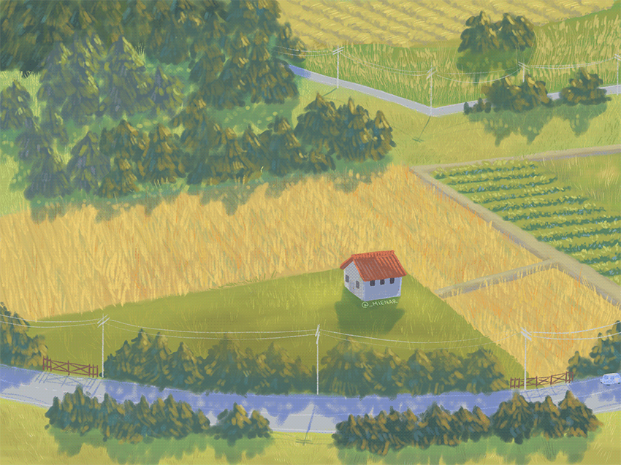

What a nice sunny day….

Slide 2
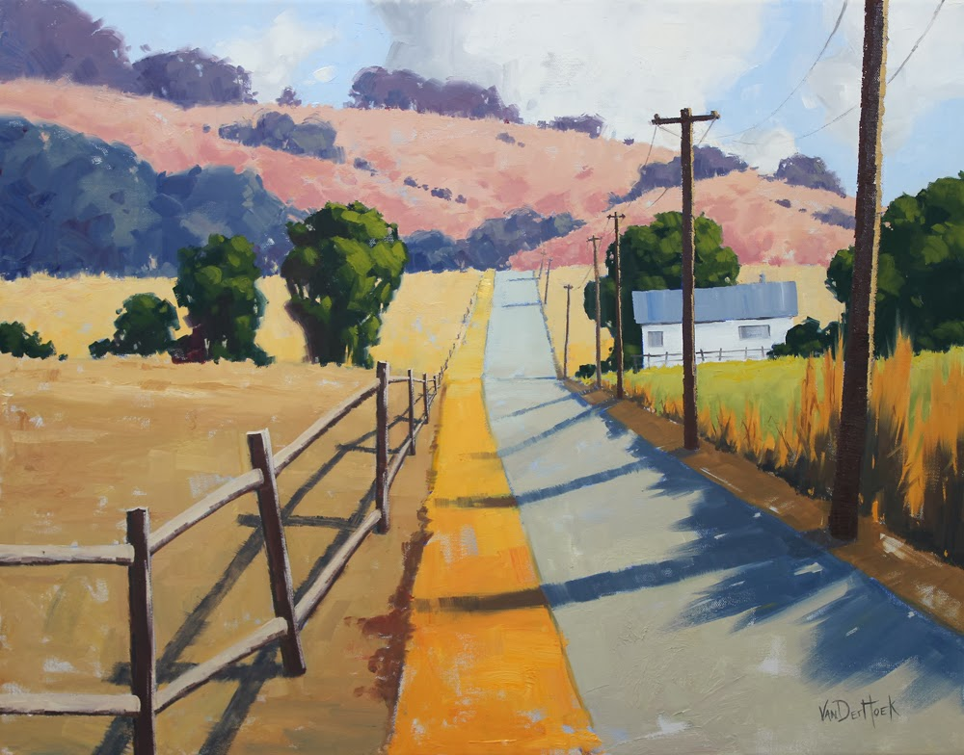
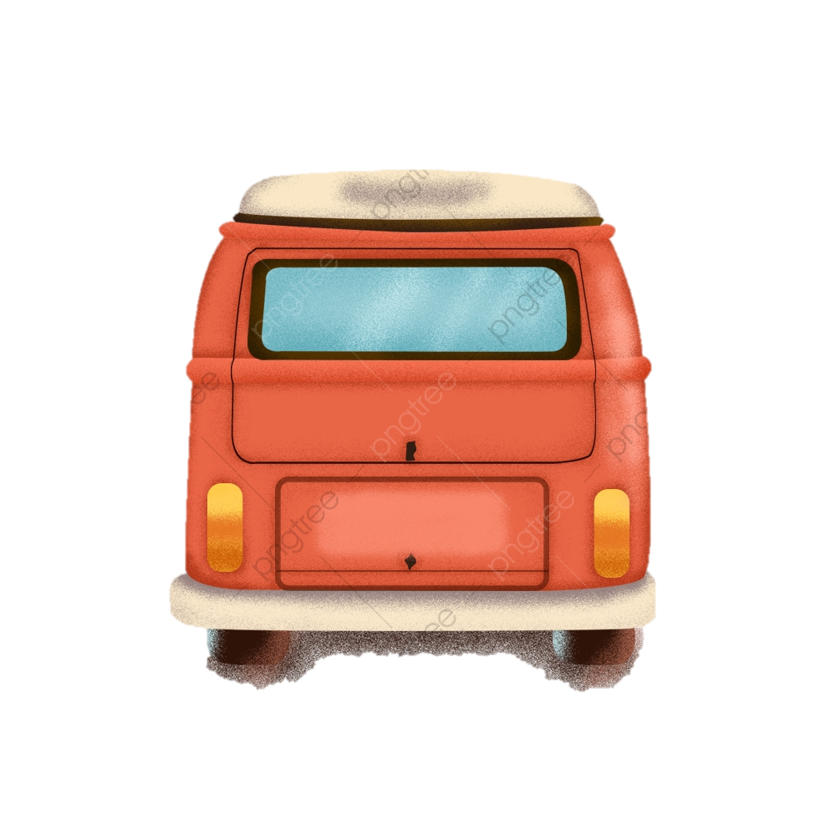

Slide 3



I must remember to spray the potatoe fields with insecticides
I wonder what‘s happening in the tomato fields…
I‘m definitely forgetting something important….
I wonder which fields there are nearby…?

Slide 4

If only there was some app that could track all my thoughts…

Slide 5

We have an App for you!
Read Notes
Take Notes
Get Field Updates
Show Nearby Fields
Receive Notifications
Get Field Flag

Slide 6
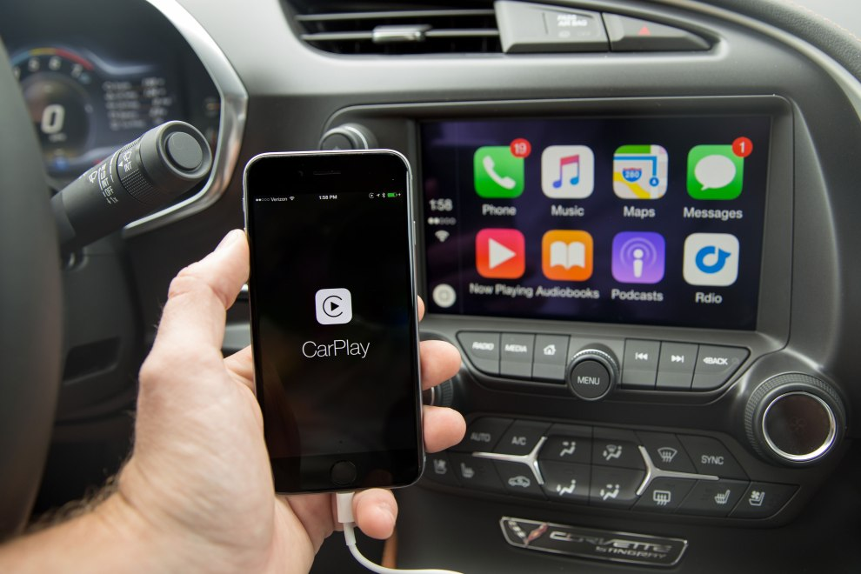

Bring your office to your car!

